Slide 1
Problem Statement
Title:PS-12 Knowledge Representation and Insight Generation from Structured Datasets
In today's data-driven world, organizations face significant challenges:
Data Overload: Vast amounts of data stored in CSV files, often underutilized.
Technical Barrier: Complex analysis tools require specialized skills
Time Constraints: Traditional analysis methods are time-consuming
Insight Gap: Difficulty in extracting actionable insights quickly
Accessibility: Limited tools for non-technical users to interact with data
These challenges lead to missed opportunities and inefficient decision-making processes.

Slide 2
Unique Idea Brief (Solution)
The Knowledge Representation project uniquely combines three powerful features to transform raw data into actionable insights. The Insights Generation feature leverages advanced data analysis techniques and visualization libraries to automatically uncover patterns and present them through interactive charts.
The Chat with CSV feature innovatively uses LangChain and Google's Generative AI to enable natural language interaction with data, translating user queries into SQL and providing conversational responses.
The ML Prediction feature seamlessly integrates various machine learning algorithms, automating the entire process from data preparation to model selection and prediction. This integration creates a user-friendly, end-to-end solution that democratizes data analysis, making complex insights accessible to users of all technical levels, and bridging the gap between raw data and informed decision-making.

Slide 3
Features Offered
Insights Generation:
Automatically analyzes the dataset, identifies patterns, creates visualizations, and provides a summary of key findings.
Chat with CSV:
Allows users to interact with their data using natural language queries, translating questions into SQL queries and providing human-readable responses.
ML Prediction:
Offers predictive analysis capabilities, automatically preparing data, selecting appropriate models, and enabling users to make predictions on new data points.

Slide 4
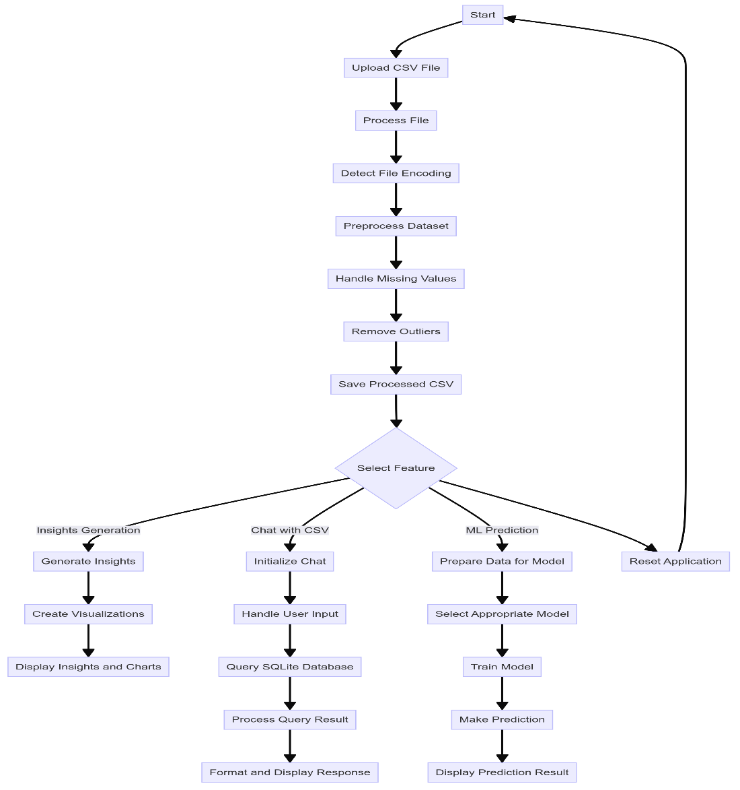
Process flow

Slide 5
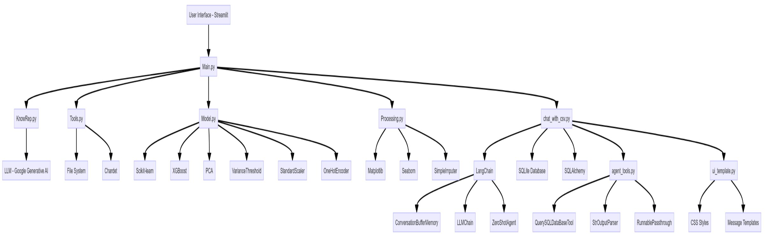
Architecture Diagram

Slide 6
Technologies used
Python: Core programming language for backend logic
Streamlit: Creating interactive web applications
Pandas: Powerful data manipulation and analysis
Scikit-learn: Comprehensive machine learning functionality
Matplotlib & Seaborn: Advanced data visualization
LangChain: Enhancing natural language processing capabilities
Google Gemini API: Large language model for sophisticated chat responses
XGBoost: State-of-the-art gradient boosting for machine learning
NumPy: Efficient numerical computations
SQLite: Lightweight database for data storage and querying

Slide 7
Team members and Contribution:
Naveenkumar D: Project Coordinator & KnowRep and Tools .
Mithun Raaj S: Model Creation and Prediction.
Siranjeevi K: Chat with CSV and agent_tools.
Pathmesh G & Ponnarasu A: Frontend Streamlit & Report .

Slide 8
Conclusion
Looking ahead, we envision:
Expanding file format support beyond CSV
Implementing more advanced NLP for nuanced conversations
Integrating with popular cloud storage and BI tools
Developing collaborative features for team-based analysis
KnowRep isn't just a tool; it's a gateway to unlocking the full potential of your data.

